Slide 1

From Reactive to Proactive:
5 best practices to reduce risk through autonomous patching
From Reactive to Proactive:
5 Steps to Autonomously Patch Vulnerabilities
Notes:
Speakers: Nadir Ahmed (Sales Engineer @ Adaptiva) & Jeff Day (Regional Vice President, EMEA @ Adaptiva).

Slide 2
Fast Facts The fastest way to identify endpoint vulnerabilities and patch them at scale
Leader in autonomous endpoint management
Privately-owned, headquartered in Kirkland, Washington, USA
OneSite Platform including OneSite Patch, OneSite Anywhere, OneSite Health, OneSite Wake
250+ Global 2000 customers, across every industry, largest banks, retailers, & gov orgs in world, 10M+ licensed endpoints
Award-winning customer support team
© 2024 Adaptiva. All rights reserved.
Notes:
So, who are Adaptiva? We work with IT and cybersecurity leaders who want to fully automate their approach to patch and endpoint management.
Our product is called OneSite, and it is a platform for endpoint management solutions, including OneSite Patch.
Our team has extensive enterprise IT experience, we have experts—who were system administrators and led IT teams at enterprise organizations.
Adaptiva has been around for 20 years working with hundreds of the largest organizations across the world and we have a long list of satisfied customers, including some of the largest retailers, all the top banks, and companies like FedEx, USPS, and Coca Cola.

Slide 3

















































































Proven & Trusted Adaptiva is speeding autonomous endpoint management for the world’s largest organizations
Notes:
Here are just a few examples of the customers that we work with across the world.

Slide 4













The Fastest Way to Patch & Manage Endpoints at Scale
“Humans should define strategy and process and software should do the rest.”
– Dr. Deepak Kumar, Adaptiva, Founder & CEO
PATCH AUTOMATION
SOFTWARE DISTRIBUTION
AUTO-REMEDIATION
POWER ON DEVICES
OneSite Patch
OneSite Anywhere
OneSite Health
OneSite Wake
Automate. Adapt. Accelerate.
Peer to Peer
Bandwidth Optimization
Orchestration
Smart Storage
Real-time Reporting
OneSite Platform
Autonomous endpoint management to rapidly remediate vulnerabilities and deliver content to any number of endpoints—no matter their location or network connection
Notes:
Adaptiva is the autonomous endpoint management company – we make it easy to patch and manage endpoints at speed and scale.
All of our solutions are built on the OneSite Platform – which helps increase speed of remediation and content delivery while reducing infrastructure.
The OneSite Platform uses secure P2P architecture, adaptive orchestration, and serverless storage to help automate, adapt and accelerate endpoint management.
Each of our solutions, including OneSite patch are built with these capabilities.

Slide 5




Adversaries are faster and eCrime business is booming.
Your endpoints are the critical attack vector.
increase in ads for selling credentials
of successful cyber attacks
*62 Min
Average eCrime breakout time
*147%
90%
Easy access for aspiring eCriminals
Begin on an endpoint
*2024 CrowdStrike Global Threat Report; Cost of a Data Breach Report, Ponemon and IBM, 2022, State of Cyber Assets Report, JupiterOne, 2023
Notes:
Let’s talk about the issue we are faced with today!
Adversaries are faster. The Cyber Crime business is booming. And your endpoints are still a critical attack vector.
When it comes to the speed of the adversary, year-over-year they’ve gotten even faster, with no signs of slowing down. It only takes 62 minutes for an attacker to land on the first endpoint in your environment and then begin to move laterally across the network. CrowdStrike call this metric the breakout time, and it has been reducing every year. Imagine what will happen when they begin to use AI more.
Cyber criminals are buying illegal access to organizations that other cybercriminals are selling on forums and the dark web, and CrowdStrike observed a 147% increase in the number of ads for selling credentials. A cyber criminal doesn’t need to be technical expertanymore, they just need to login with stolen credentials, the equivalent of walking in through the front door.
90% of all successful attacks continue to begin on the endpoint. This means, it’s a key areas we need visibilty on and protect. We need to make sure endpoints are secure and compliant. But unfortunelty, it’s taking organsations t0o long to patch.

Slide 6
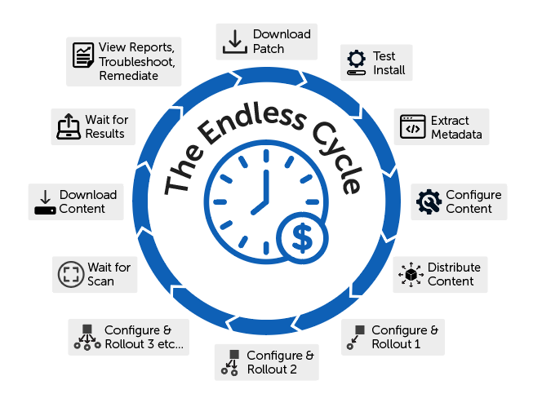

The Patching Problem: Manual Processes & Waiting for Certainty
Gartner estimates that fewer than 60% of devices are patched within 14 days, and most organizations require 30 days or more to reach 90% completion.
Notes:
According to Gartner, most organizations are taking a month or more to reach 90% patch compliance.
The problem here is that the longer devices are unpatched the more they are at risk.
But why is it taking so long to patch? It’s a manual process filled with delays and roadblocks that leave critical vulnerabilities unpatched.
The Endless Cycle is a long tedious process to deploy patches. And it is done for every single patch that has to be deployed – making it an endless cycle, a treadmill.
This doesn’t even include the process of finding the patch, researching to determine if the patch is a priority, making sure you are downloading the patch from a valid website before you go through the deployment process etc.
How long is it taking your organization to patch?
It’s important to think about accelerating that process

Slide 7
Bridging the gap between security and IT
Siloed vulnerability management
Proactive patch management
Notes:
Organizations need to make this shift from cautiously and slowly reacting to identified vulnerabilities, to rapidly and proactively patching them before they are exploited. But how do we do that?

Slide 8




The fastest way to prioritize and patch vulnerabilities at scale
Discover
OneSite Patch integrates with vulnerability management to close the loop on patching while maintaining visibility and control.
Identify, prioritize and patch your most critical vulnerabilities, automatically.
Vulnerability management
+
Remediate
Assess
Prioritize
Microsoft Defender
Notes:
That is what we are going to discuss today. How to achieve proactive patching automatically through the integration of Vulnerability Management solutions with Adaptiva’s OneSite Patch.
Through these integrations, such as Microsoft Defender and Falcon Exposure Management, you can discover and prioritize vulnerabilities in real time, and OneSite Patch uses that threat intelligence to automatically remediate vulnerabilities.
This allows companies to identify their most critical vulnerabilities and fix them fast with patching precision. No one else on the market is uniting vulnerability management and autonomous patching like this at scale today, and we believe that this integration will help bridge the gap, between identifying vulnerabilities and remediating them.
We’ll start by talking about the first step of proactively discovering and assessing vulnerabilities and patches.
.

Slide 9
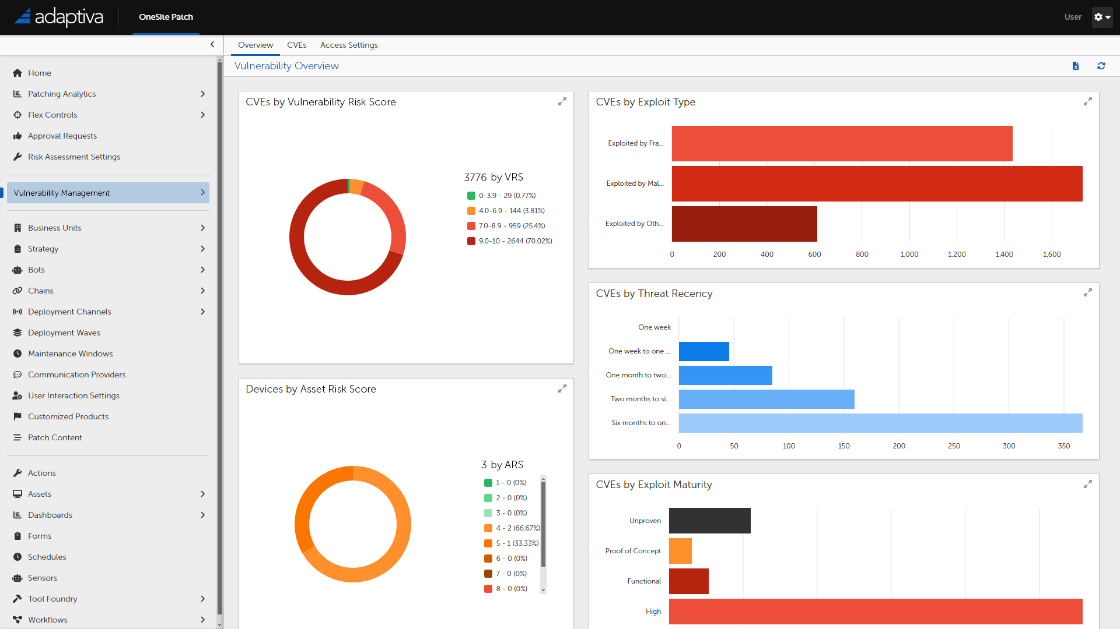

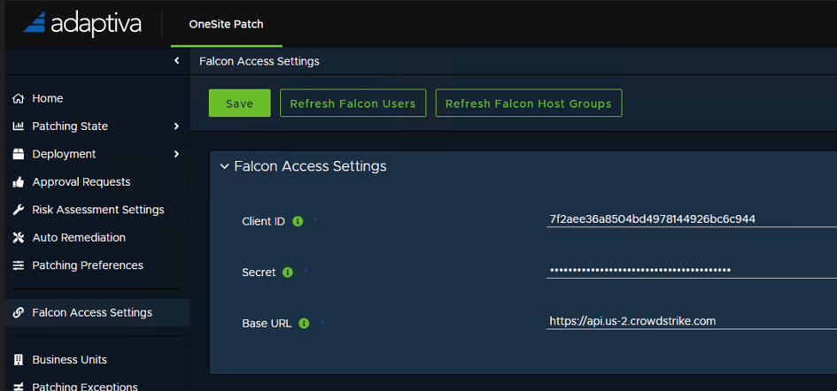
1. Proactively Discover & Assess Vulnerabilities & Patches
Automate the collection of:
CVE, CVSS
Criticality factors from 3rd party vulnerability management systems
Patch metadata
Ask vendors:
Do they assess criticality factors for vulnerabilities? What data do they capture to make those assessments?
How current and large is their patch library?
Notes:
The first thing companies can do, to stop being reactive to breaches, is to Proactively Discover & Assess Vulnerabilities & Patches….
This can be achieved through real-time identification of vulnerabilities and understanding their severity levels by using data from various sources, including CVEs, CVSS score, AI and more. This is built into OneSite Patch, but you can also pull in data from Defender or CrowdStrike.
Combine this with information on the latest patches available and you have a winning combination to act on those vulnerabilities.
If you are evaluating vendors in this space, make sure to ask them:
Do they assess criticality factors for vulnerabilities? And if so, what data do they use for this?
How up-to-date and large is their patching library?
For automation to work well, it needs to start with data and insights that help point it in the right direction and prioritize what matters most.

Slide 10

2. Model Your Vulnerability Remediation & Patching Strategies
Before you automate…
Set up precision patching rules for vulnerabilities based on your unique business rules and patching strategies
Ask vendors if they support patch customization by:
Geography & Locations
Business Units
Devices, Servers, Groups & Types
Test Groups
Tiered Deployments
Schedules/Maintenance Windows
Notifications
Notes:
The second, best practice for embracing autonomous and proactive patching is to define precision patching rules for vulnerabilities, based on your unique business rules, & to develop patching strategies BEFORE you automate.
Humans should set the strategy and processes for vulnerability remediation and let software do the rest.
The only way this works is if you can get incredibly granular in setting those rules so they can align with the unique rules and complexities of your business.
That is why it is important to ask vendors if they support patch customization by:
Geography & Locations
Business Units
Devices, Servers, Groups & Types
Test Groups
Tiered Deployments
Schedules/Maintenance Windows
Notifications

Slide 11

3. Automate Your Patch Deployments
Get faster with trusted automation
Schedule and prioritize automated patch deployments using real-time vulnerability data to ensure all critical vulnerabilities are patched immediately
Ask vendors if they:
Support multi-level approvals management checks prior to deployment
Offer patch exception handling and custom installation settings
Notes:
Now that you have identified your vulnerabilities and set up your patching strategies it is time to automate those patch deployments.
We have already shown you all the reasons you need to use automation to remediate vulnerabilities faster and reduce risks. The best practices here is to schedule and prioritize automated patch deployments using real-time vulnerability data to ensure all critical vulnerabilities are patched immediately.
If you are evaluating vendors in this space ask them if they can
Support multi-level approvals management checks prior to deployment
Offer patch exception handling and custom installation settings
So that you can automate fast but always under control.

Slide 12

4. Monitor the employee experience and ensure controls are in place for when things go wrong
Patches break things. Be prepared with flexible controls.
Ask vendors if they can:
Pause, cancel, and rollback patches at scale
Notify employees, executives, or administrators about patch deployments
Apply a configuration change instead of a patch
Gather user sentiment data on patches
Notes:
Speaking of controls, we all know that patches can break things. This is why it is important that to move from reactive to proactive you must continuously monitor the employee experience and ensure controls are in place for when things go wrong.
Autonomous patching vendors need to deliver flexible controls that let you:
Pause, cancel, and rollback patches
Notify employees, executives, or administrators about patch deployments
Apply a configuration change instead of a patch
Gather user sentiment data on patches

Slide 13
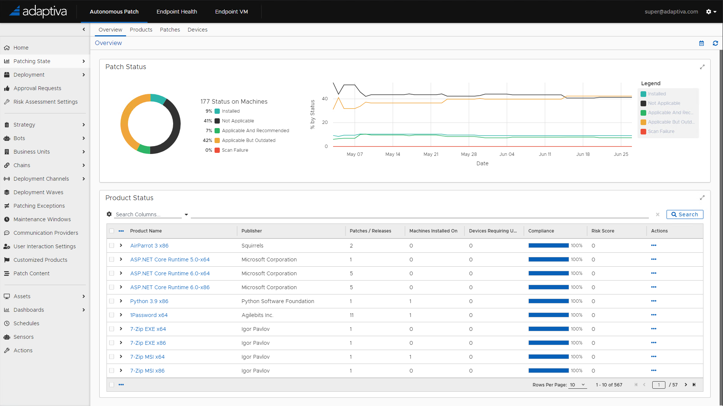
5. Analyze and report on patching results and vulnerability remediation compliance
Consistently review dashboards and reports for instant analysis into patching metrics, risk, compliance and more
Ask vendors:
What reporting do you deliver? Is it real time?
Is it easy to take action on information in dashboards?
Notes:
Finally, through the whole vulnerability identification and patching process, you need visibility in your progress through real-time reporting and dashboards.
Consistently review dashboards and reports for instant analysis into patching metrics, risk, compliance and more
And ask your vendors
What reporting do you deliver? Is it real time?
Is it easy to take action on information in dashboards?

Slide 14














































































































































A Growing Catalog of 1600+ Third Party Apps + Windows
Dedicated Metadata team collects, configures and maintains patches for Windows Update catalog alongside a growing library of more than 45,000 patches for 1600+ unique 3rd-party products, applications, and drivers. Updated daily.
VIEW LIBRARY

Slide 15
OneSite Patch Demo
Are you ready to see how fast you can patch?

Slide 16
OneSite Patch MVP Referral Program
2024
Notes:
Microsoft MVP Referral Program

Slide 17
OneSite MVP Patch Referral Program
<5k Endpoints
5% Referral bonus on closing
5k+
Endpoints
$1000 referral bonus + $1000 bonus on closing
Deal Registration
All opportunities must be registered in Adaptiva Partner Portal and will be confirmed as a new lead
Closed deals

Slide 18
Register Referrals:
Deal Information Required:
Company Name
# of endpoints
Contact person name
Contact person email
Contact person phone
Note: Adaptiva will confirm the lead is new and Adaptiva has not already been in contact with them.
https://adaptiva.com/partners
Click on “become a partner”

Slide 19
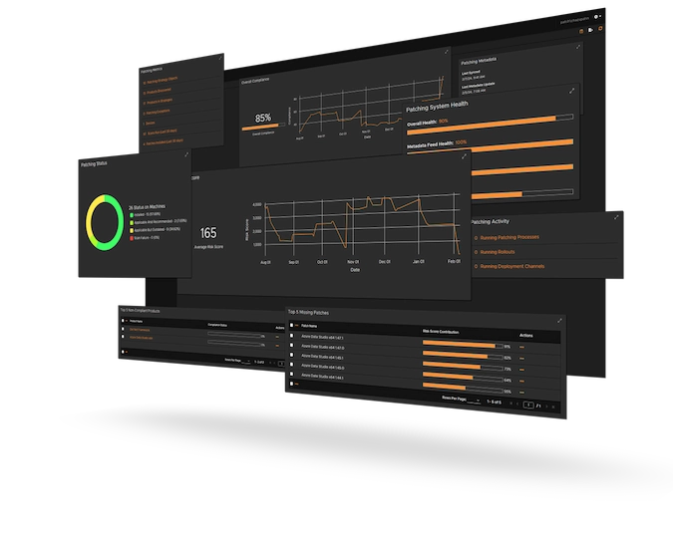
Get a 1:1 demo
Visit our table to view or schedule a custom 1:1 demo to learn how OneSite Patch can help your organization

Slide 20

Thank you! Questions?

